Slide 1




<Insert Company Name>
Energy Treasure Maps Project
Sample Company Logo

Slide 2

GM Partnership Goals
ZERO CRASHES
ZERO EMISSIONS
ZERO CONGESTION
We are committed to SAFETY in everything we do
We earn CUSTOMERS for life
We build BRANDS that inspire passion and loyalty
We translate break though TECHNOLOGIES into vehicles and experiences that people love
We create SUSTAINABLE solutions that improve the COMMUNITIES in which we live and work
Note to User:
Insert Supplier Sustainability Outlook, Goals, Initiatives

Slide 3






Introduction
Treasure Map Process Overview
High Level Findings Summary
Agenda
Overview of Projects/Savings Opportunities
Q&A
Made possible through utilization of the GM Treasure Maps Program
Notes:
Speaker: Avtar

Slide 4
Meet The Team
Insert picture
Insert picture
Insert picture
Insert picture
Insert picture
EX. John Smith
Sustainability Analyst
j.smith@gm.com
+1.999.999.9999
Name
Position
Email
Phone #
Name
Position
Email
Phone #
Name
Position
Email
Phone #
Name
Position
Email
Phone #

Slide 5
Our Energy Treasure Maps Program
BACKGROUND CONTEXT
The Energy Treasure Maps Program is a tool created by GM that helps highlight the areas that we should focus our efforts on based on cost savings, reducing emissions, and improving efficiency.
  Current State: Completed the Energy Treasure Map
  Future State: Implement the projects with less than 2 years payback period
HIGHLIGHTS
Top projects identified:
Project 1
Project 2
Project 3
NEXT STEPS
Implement the projects and monitor the energy savings. Report savings results.

Slide 6

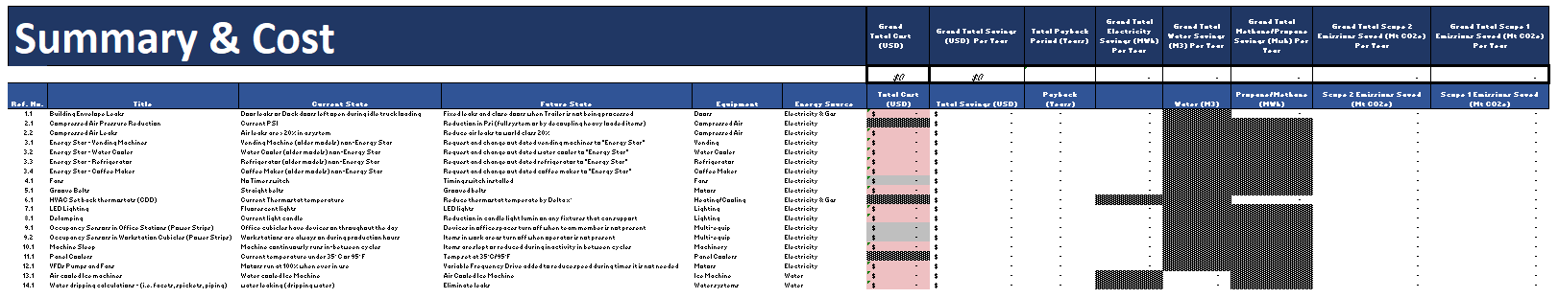
Treasure Map Summary
1. Summary of usage and savings
2. Action Items
Note: values are being used for visual purposes only
Notes:
Speaker: Bob

Slide 7
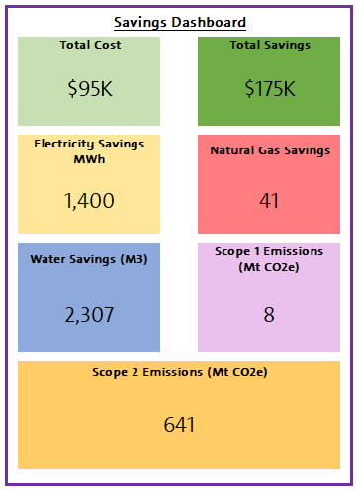
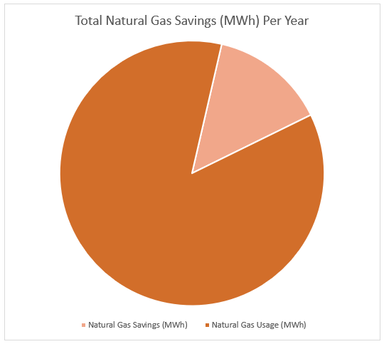
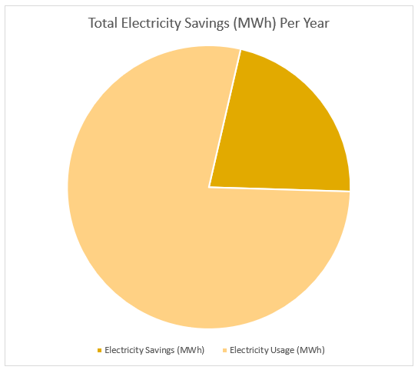
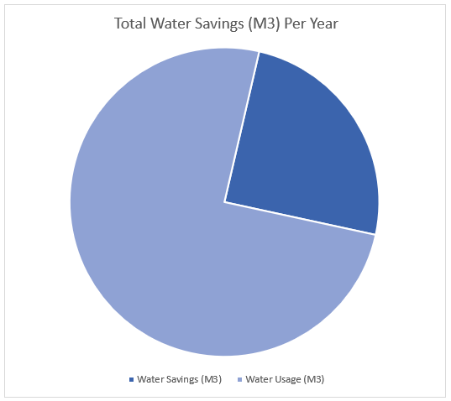
Energy Savings Saved vs Total Usage
Note: values are being used for visual purposes only
Notes:
Speaker: Nathalie

Slide 8


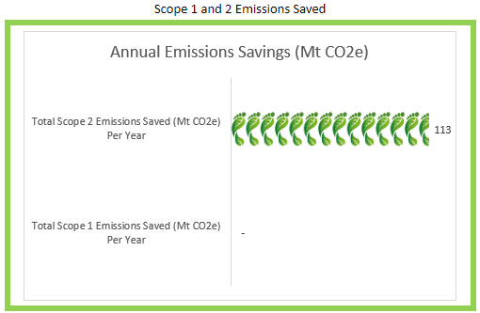
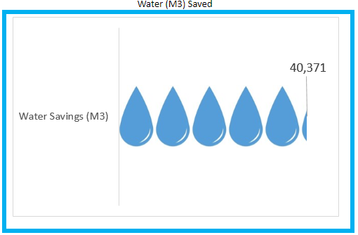
Scope 1 & 2 Emissions & Water Savings
Note: values are being used for visual purposes only
Notes:
Speaker: Nathalie

Slide 9
Top 3 Projects
1
<Insert Project, Equipment or Facility Photo>
<Insert Highlight Detail>
2
<Insert Project, Equipment or Facility Photo>
<Insert Highlight Detail>
3
<Insert Project, Equipment or Facility Photo>
<Insert Highlight Detail>

Slide 10


