Slide 1
The Alchemy of Innovation
Notes:
1

Slide 2
About Vectorform
Vectorform invents digital products and experiences. As an
elite team of artists, engineers, entrepreneurs and intellectuals, Vectorform is a global design and technology firm specializing
in emerging digital experiences for the world’s leading brands.
Notes:
Vectorform is a modern digital consultancy and design studio.
And our staff is a nicely balanced blend of Designers, entrepreneurs, engineers, and intellects

Slide 3
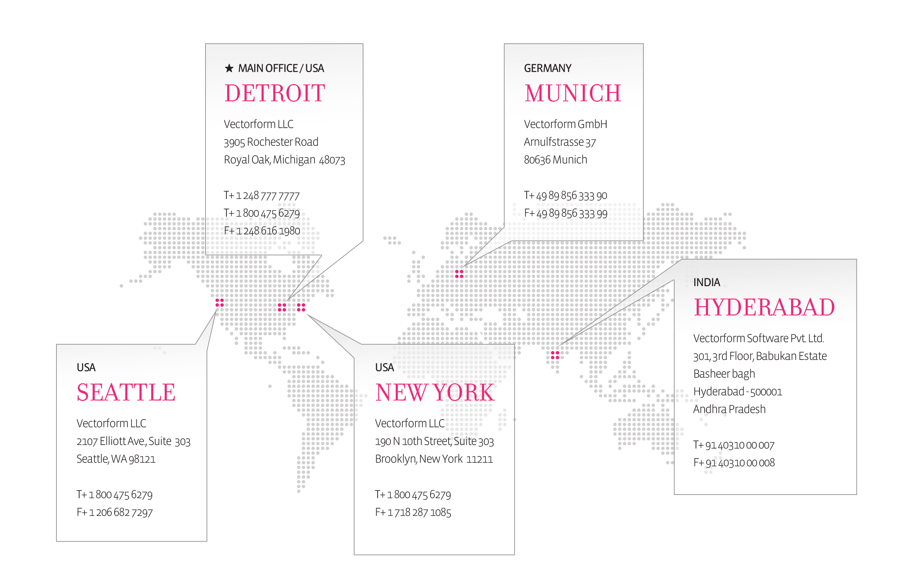
About Vectorform
Vectorform’s work spans mobile, video game, desktop, online, in-vehicle, and next-generation platforms. Our award-winning expertise in creating cross-platform interactive experiences and our reputation as a tenacious, outcome-oriented partner is unmatched.
Founded in 1999 in Detroit, MI
Owned and operated by managing partners Jason Vazzano, Kurt Steckling, and Karl Steckling
Global offices in Seattle, Detroit, New York, Munich, and Hyderabad
100+ employees
Notes:
We have 5 office globally. Three here in the states. Royal Oak Michigan is our headquarters. We just moved into our brand new facility yesterday in fact, so the address on the slide is wrong.
We have an East Coast Presence in Brooklyn New York
And we have a West Coast Presence in Seattle Washington
Internationally, we have an office in Munich Germany that serves our EMEA based customers
Finally, we have our office in Hyderabad which is the focus for our Asian customers.

Slide 4
Vectorform Culture
THINK TANK
Relentlessly challenge
Tackle long-range issues
Predict behavioral patterns
Stimulate fields of excellence
Our principles of thought leadership, experimentation, and execution attract a wide spectrum of leaders in marketing, information and technology alike. We combine these principles to create conditions for “Cultivating Genius”.
Cultivating genius means delivering best-in-class contemporary insight to create game changing experiences for consumers.
LAB
Invent and evaluate
Prove concepts
Build powerful new tools
Hardcore engineering
STUDIO
Evolve human experience
Create new modes of expression
Progress development and delivery
Empower Excellence
Notes:
Why has VF been effective at innovation?
We put user experience first
Design is no longer an afterthought
We begin with the user experience first, We call the Natural User Environment
We start our projects by focusing on what the needs of the customer are. From that perspective we look at what digital technologies can enhance that experience
How can we satisfy the customer’s needs in the best way possible.

Slide 5

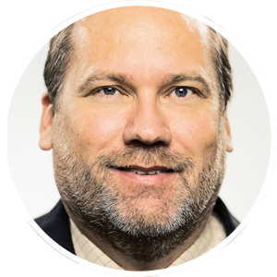
Edward Wrenbeck
CHIEF TECHNOLOGY OFFICER | VECTORFORM
Notes:
My name is Ed Wrenbeck and I’ve been with Vectorform a little over 4 years
I’m the Chief Technology Officer
Prior to that, I was involved in a few start-ups, including Siri, which you may have heard of
and a company called Modern Feed that was ultimately bought by CBS
Before then, I have a long history of being a serial IT consultant.

Slide 6

Alchemist
Notes:
Who here is an alchemist?
What is alchemy AND what does it have to do with innovation? (why is this speech called the alchemy of innovation)
Alchemy is a very misunderstood word. Most people associate it with some sort of magic.
One of Arthur C Clarke’s Three Laws states “Any sufficiently advanced technology is indistinguishable from magic.”

Slide 7
The Alchemy of Innovation
“A seemingly magical process of transformation, creation or combination.”
“The process of taking something ordinary and turning it into some extraordinary, sometimes in a way that cannot be explained.”
Notes:
In fact, one of the definitions defines alchemy this way:
“A seemingly magical process of transformation, creation or combination.”
I prefer the definition which defines alchemy as:
“The process of taking something ordinary and turning it into some extraordinary, sometimes in a way that cannot be explained.”
I’ve also seen it defined as “The creation of something of value from something mundane.”
Clearly, you can use any of these definitions to explain the process of innovation. In essence, the process of innovation is the performance of alchemy. And, the people we think of as innovators take everyday things around us and create something extraordinary and valuable by combining those everyday things in a unique and new way.
Let’s look at the original iPhone as an example of alchemy – combining and transforming something already in existence into something extraordinary.
I use the iPhone because it’s everywhere and everyone gets it. But what some of you might not understand is that the core components making up the iPhone software were in existence all the way back beginning in the 70s.
From there, innovators – “alchemists” began to combine and transform the software, code and technology available to them in unique and new ways. As alchemists, they were constantly testing, probing, pushing to arrive at the end result – the iPhone we have today.
This example just shows how Apple took long established ideas that have been around 20 years and wrapped these ordinary things and created something extraordinary and innovative. (Not to mention incredibly valuable)
Now that we have defined the process of innovation as an expression of alchemy, let’s look at how we can become alchemists.
7

Slide 8

Outsource
AKA Jumping the shark
Notes:
The first choice we should consider is to outsource your innovation entirely.
It sounds crazy right? In fact, this is an option that many companies elect to pursue, whether they realize it or not.
The most popular way to outsource innovation is to create a venture group within or as an extension of the company. You won’t believe some of the companies that have VC components. Did you know that DTE Energy, a prototypical fortune 500 Edison company, with a utility monopoly, has a VC arm called “DTE Ventures”? Visa and salesforce have venture arms and in fact are both invested in the same startup.
In 2013, there was 48.5 billion invested in Venture Capital worldwide. (According to Earnst & Young)
So the obvious question is why? Why? Why do these companies create venture capital arms?

Slide 9
Research shows that “Large companies in active sectors facing rapid technological change more often run a VC program”.
Another factor is “Innovation performance relative to the company’s aspirations is an important driver of the decision to run a VC program”.
Notes:
Research shows that “Large companies in active sectors facing rapid technological change more often run a VC program”.
Another factor is “Innovation performance relative to the company’s aspirations is an important driver of the decision to run a VC program”.

Slide 10
The Alchemy of Innovation
To put it into non-research terms, these companies are admitting defeat. It’s a statement that says “Our corporate culture is so incapable of enabling innovative thinking that we have to find others to do it for us”.
Notes:
To put it into non-research terms, these companies are admitting defeat. It’s a statement that says “Our corporate culture is so incapable of enabling innovative thinking that we have to find others to do it for us”.
The story of salesforce is one of the most interesting examples to me. Here’s a company, 15 years old, and just last month set up their own venture arm funded with 100 Million Dollars.
WHY?
Now, I’m sure salesforce can provide multiple flowery statements about why they created their VC arm, but the real reason is that they have grown so big, so siloed, and so entrenched in their own business that they can no longer internally innovate effectively and are now looking to invest in more agile companies that can do it for them.
10

Slide 11
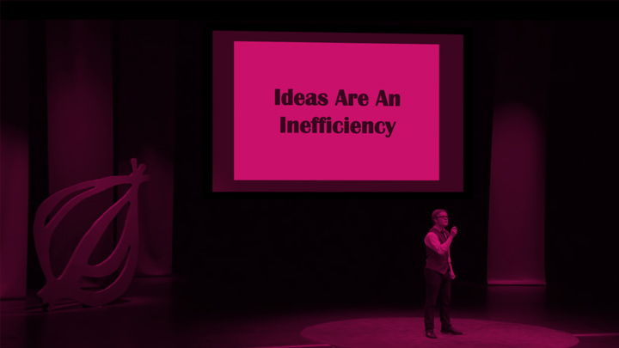
Ideas are an inefficiency
A LOOK AT THE INDUSTRY
Notes:
Now, of course, the other advantage to having an outside company provide your innovation is that great progress usually arises from great need. I recently watched a “Ted talk parody” that included a statement that is more true than not.
“Ideas are an inefficiency”.
It’s actually quite true. Why are ideas inefficient? Because ideas require work to realize. Take a moment to think about that. in MOST companies ideas are an inefficiency. Now think about the company you work at right now. Are ideas an inefficiency in YOUR company today? Companies live in fear of getting their product launched before they run out of money or miss the window to capture market share.
When you’re in a position like Microsoft today, making billions of dollars in profit – each quarter – do you really need to worry about generating completely new and innovative ideas? that we have shown are inefficient? Well let’s take a look at Blackberry, they were in a similar situation just a few years ago and we all know what happened to them. Currently struggling to survive and find relevance.
While venture strategies for innovation have their place we’re here to discuss how you can become alchemists for innovation within your own company.

Slide 12

v
Create the right environment
Notes:
Create the right environment.
Roman Bath Houses
English Coffee House - enlightenment – 1500
Stephen Johnson - Where ideas can have sex
Coral Reefs and Rainforests - places where great natural ideas come from
Innovation comes from connecting several ideas together to create that something new and valuable. There has to be a place where ideas can meet-up and mingle. If your ideas can only mingle with themselves, you’ll end up with inbred ideas that begin to drift away from a natural evolution.
Does your company have these natural meet-up spaces. Do people in your company have a fluid environment to collaborate?

Slide 13
“The fastest answer you can get from a government employee is their retirement date.”
“Entrepreneurship is a team sport”
Notes:
I was recently at an innovation summit hosted by HP with Ric Snyder - The governor of Michigan for the out of state travelers here. One of the things he said during his speech is:
“The fastest answer you can get from a government employee is their retirement date.”
But he also said:
“Entrepreneurship is a team sport”
Which is probably more relevant to today’s talk.
To take it one step further, having a proper field for the team to play on is critical.
So, step 1 in bringing innovation to your company is to create the right environment where ideas can mingle. Unfortunately, it can’t be around the water cooler or at a weekly brown bag lunch. It has to be constant, always on with people of mixed skills and backgrounds and ages.
There aren’t any shortcuts; it takes a real commitment. I personally believe it’s not as effective when it’s done virtually either. I’ve worked at or with many companies that have systems in place. They never work. Even today, we have internal systems in our companies to enable collaboration; We call ours ‘brainchild’.
While the system is a great collaboration environment, it just doesn’t work. It seems that ideas have a hard time mingling virtually. Ultimately, I think it boils down to synchronous communication. Asynchronous systems introduce friction that dilutes the power of the ideas. Ideas need to touch each other and spend time mingling with each other.
There can be an exception. I was recently out at NBC Universal to look at some of the innovation they are bringing to their IT department. They have introduced always on video conferencing where teams from separate locations effectively sit together all day. So, imagine a large screen that you can walk up to, see which colleagues are there sit down and have an instant conversation. The key is that it’s synchronous and always on. You don’t have to initiate a call, schedule time or anything else that brings friction into the communication.
Ultimately, the goal is to create that rainforest in your company. And more importantly, USE IT. If anyone in the company feels like they can only go there at a certain time, talk to certain people or only stay for so long, it won’t be long before the ideas start inbreeding again.

Slide 14
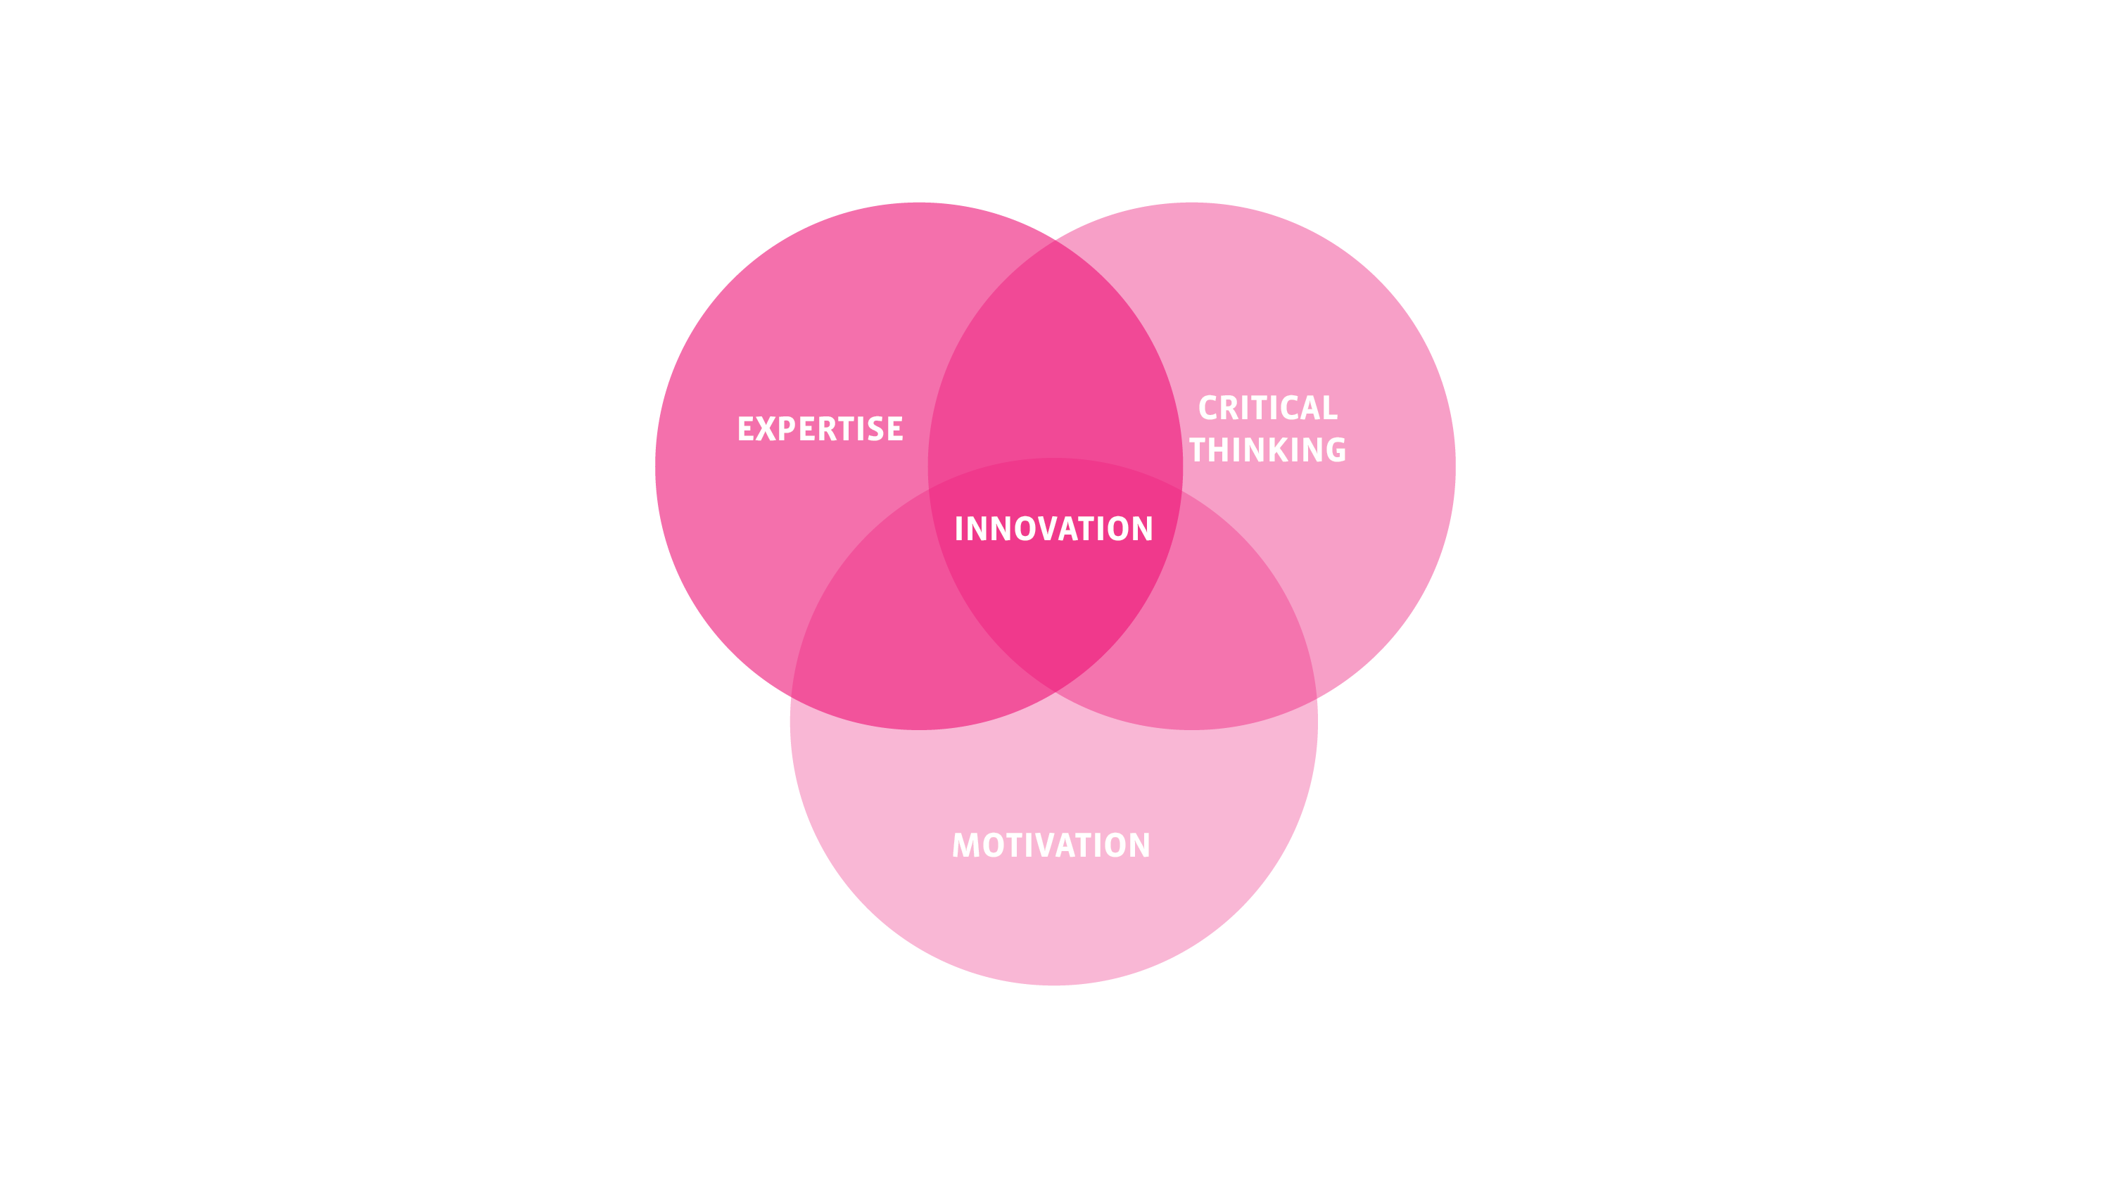
The Alchemy of Innovation
Notes:
Get the right people
Digging into research on what great innovators do differently than everyone else, one consistent observation arises. Great innovators are intrinsically motivated.
So what the heck does “Intrinsically Motivated” mean??
There are two types of motivation at play in anything you do, broken down as intrinsic and extrinsic. We, as corporate folk, tend to only think in extrinsic terms. AKA Carrots and Sticks. We pay you to do your job, we give you a bonus for success, or worse, we fire you when you fail.
While Carrots and sticks are great, and they are needed, they won’t help you bring innovative people into your company.
Innovators are primarily motivated intrinsically. They do things because they want to change the world. They work hard because they are passionate about what they are doing. There is a great TED talk by Simon Sinek, where he states it best:
“You must hire people that believe what you believe.”
The people that will create great innovation for you are the people who are intrinsically motivated because they believe in what you are doing.
So now, we’ve talked about whom you need to innovate and where they need to be to do it. Finally, let’s talk about the how.
14

Slide 15
The Alchemy of Innovation
Stabilize. Optimize. Innovate
Notes:
We have a pretty simple mantra at Vectorform that we bring into every project. That mantra is “Stabilize, Optimize, Innovate”. So…..how can you apply this mantra to YOUR company?
Let’s break it down.
Stabilize
In order to innovate, a stable platform must be built first. Ideas need something to stand on, they need shelter, they need some good home cooking once in a while.
Oftentimes, I get brought into companies to help them create or fix their digital or mobile strategy.
The first thing to do is to assess the current properties. I nearly always find that companies are supporting and promoting digital properties that are actively damaging their brand and reputation.
15

Slide 16
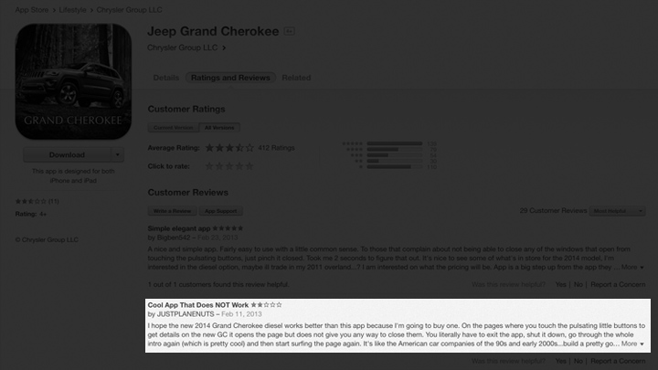
Jeep
A LOOK AT THE INDUSTRY
Notes:
What we are looking at here is a screen shot of the App Store reviews for the 2014 Jeep Grand Cherokee digital brochure. In the typical language of the sales funnel, We would call this an Awareness app
The title of the review I have highlighted is: “Cool App That Does Not Work”
And the review starts out by saying “I hope the new 2014 Grand Cherokee works better than this app…”
Even worse, this is not the only review of its type. This is one of many where the users are expressing the same sentiment.
This app is not helping Jeep sell more vehicles. If anything, it’s costing them a few sales

Slide 17
The Alchemy of Innovation
There is no point introducing a new augmented reality experience in your mobile app if the damn thing crashes every five minutes.
Notes:
There is no point introducing the latest in mobile innovation, such as a new augmented reality experience into your mobile app if the damn thing crashes every five minutes.
So start with stabilization. Look at how your users are using your work products. There are almost certainly some things that you should just stop doing today.
While I’m saying this lightly, don’t think I’m saying this lightly. Stabilizing is tough and expensive. Some babies might be thrown away and some feelings might be hurt. It’s not easy telling someone that you are pulling his or her product from the market. The worst-case scenario is when you realize that a profitable part of your business has to be pulled because it’s hurting your brand and your other products.
17

Slide 18

New Coke
A LOOK AT THE INDUSTRY
Notes:
The most famous example is “New Coke”
Talking with one of the younger guys in my office, I discovered that he had never even heard of New Coke. Aside from realizing how old I am, I realized I had better take a minute to define what new Coke is.
New Coke was introduced in 1985 as a reformulation of Coca-Cola, designed to entirely replace Coke. We call it “New Coke” now as if it was a brand, but back then it was simply the 1985 model of Coke. Anyway, it was such a disaster that they ended up reintroducing the original formula as “Coca-Cola Classic”, which is what we all drink today.
Getting a stable product may require investment and higher than normal expenditures.
Putting an app out there that does justice to the great Jeep brand and is as awesome as the product it represents is not cheap.
Trust me, I’ve quoted the price.

Slide 19
“… we had to borrow some key software engineering and QA resources from our Mac OS X team, and as a result we will not be able to release Leopard at our Worldwide Developers Conference in early June as planned.”
Notes:
Apple had to delay the release of Mac OS X Leopard for six months.
“… we had to borrow some key software engineering and QA resources from our Mac OS X team, and as a result we will not be able to release Leopard at our Worldwide Developers Conference in early June as planned.”
Why?
They put all hands on the iPhone. In other words, they invested millions of dollars in time, and billions of dollars in delayed revenue, In order to launch the iPhone. It seems obvious of course to do that now, but in reality there was no guarantee of success back then.
Apple realized that having stability in their product line up was more important than launching an incomplete product.

Slide 20
The Alchemy of Innovation
Stabilize. Optimize. Innovate
Notes:
Optimize
The good news is that once a stable base has been established, you can now look at optimization. This is where we develop that well-oiled machine that creates the freedom to focus our energy on innovation.
20

Slide 21
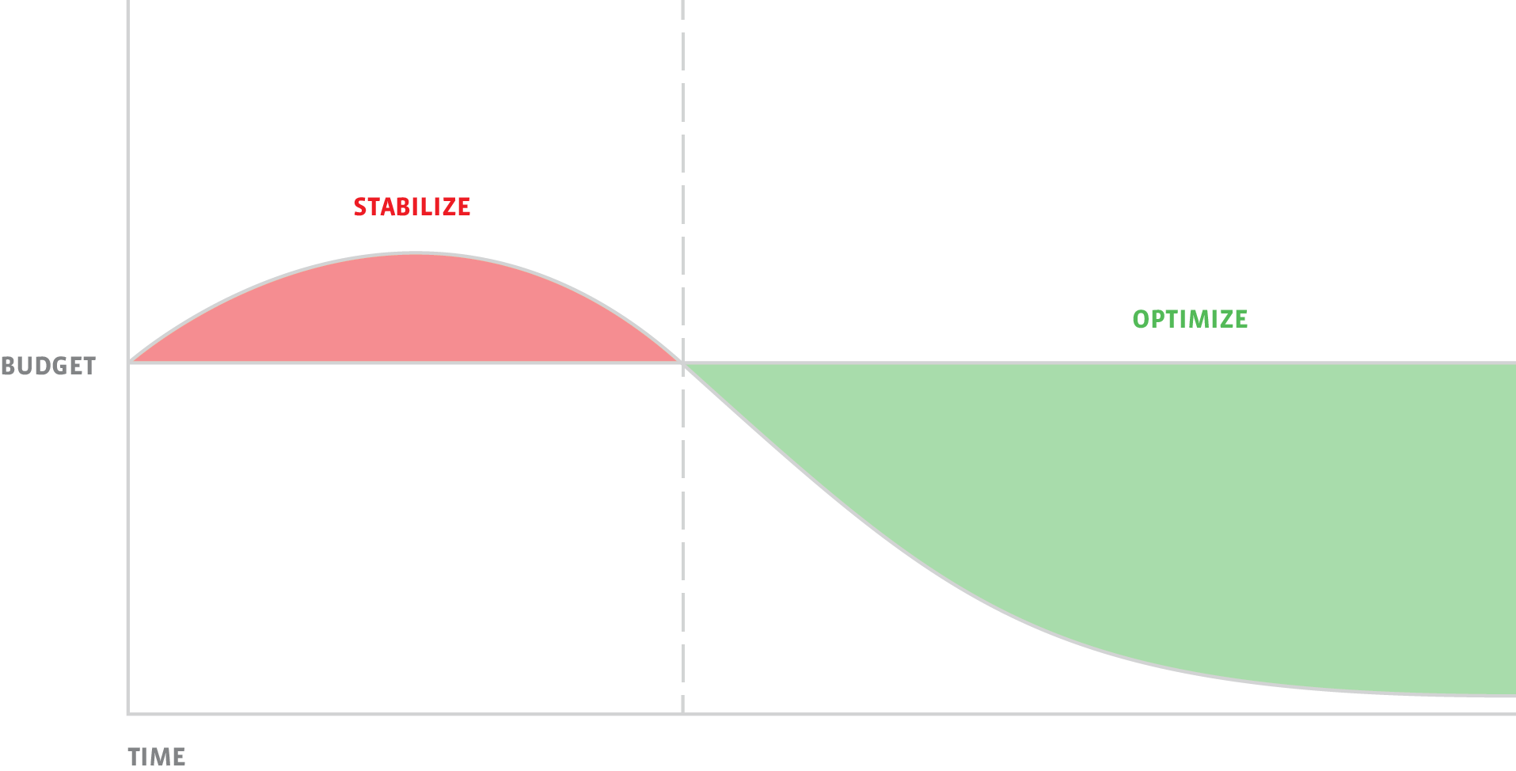
The Alchemy of Innovation
Notes:
I said a few minutes ago that getting a stable platform may require a higher than normal level of expenditures.
When we can move into optimization, we can inflect that line.
Our goal in this phase is to create that smoothly operating system, one that frees up our budget, AND our people to focus on the big win. Innovation
21

Slide 22

Comcast X1
Notes:
I was recently in Philly at Comcast doing a deep dive on their Infinity X1 platform.
Is anyone here an X1 user? [long pause]
You, as consumers, probably don’t realize this, but X1 is an amazing example of an optimized platform.
Historically, Comcast would update the software running on your cable box once every one to two years. Any amount of change was fear inducing that sent waves throughout the entire company.
I personally think this is one of many examples of how we will look back at this point in time as pre-iPhone and post-iPhone.
Comcast looked at what Apple was doing and they were releasing new updates to their users on a monthly basis, with a fairly regular cadence.
Here they are, unable to release any kind of change in less than a year and they witness Apple updating a system just as complex and with just as many users every month.
Comcast created an ingenious new system, called X1, which changes everything.
Today, if you are an X1 user, Comcast is sending updates with new features such as a new guide menu layout or different color schemes – ON A BI-WEEKLY BASIS. Additionally, they are pushing to begin weekly updates soon. They have an optimized system in place that enables their ultimate goal

Slide 23
The Alchemy of Innovation
Historically, Comcast would update the software running on your cable box once every one to two years. Any amount of change was fear inducing that sent waves throughout the entire company.
Notes:
Historically, Comcast would update the software running on your cable box once every one to two years. Any amount of change was fear inducing that sent waves throughout the entire company.
I personally think this is one of many examples of how we will look back at this point in time as pre-iPhone and post-iPhone.
Comcast looked at what Apple was doing and they were releasing new updates to their users on a monthly basis, with a fairly regular cadence.
Here they are, unable to release any kind of change in less than a year and they witness Apple updating a system just as complex and with just as many users every month.
Comcast created an ingenious new system, called X1, which changes everything.
Today, if you are an X1 user, Comcast is sending updates with new features such as a new guide menu layout or different color schemes – ON A BI-WEEKLY BASIS.
Additionally, they are pushing to begin weekly updates soon. They have an optimized system in place that enables their ultimate goal
Innovation
23

Slide 24
The Alchemy of Innovation
Stabilize. Optimize. Innovate
Notes:
We’ve gone through the pain of stabilize
we have optimized our systems
we have created an environment conducive to innovation
we have our staff of intrinsically motivated people
what’s next?
24

Slide 25
“Opportunity is missed by most people because it is dressed in overalls and looks like work”.
Notes:
One of my favorite Thomas Edison Quotes is:
“Opportunity is missed by most people because it is dressed in overalls and looks like work”.
I’ve worked at a few startup companies, one of which became world famous called Siri.
One feature that was requested for Siri to have was the ability to lift the phone to your ear and to be able to just start talking. [raise phone]
In order to do that, several things needed to happen. I had to try and create an natural curve that understood the movement of taking the phone from your pocket or hip area and lifting it to your ear. [raise phone]
I also used the proximity sensor in the phone to see that the end of the motion resulted in the phone being close to your ear and you weren’t simply swinging it around.
Finally, turning on the voice recognition engine requires about two hundred milliseconds of time. 2/10s of a second doesn’t sound like a lot of time, but think about how fast your can swing your arm up and you can begin talking.
I spent approximately two months just tweaking that formula. I had it working about 80% of the time. Of course, 80% wasn’t enough so we didn’t ship with it enabled. It was available in the settings though. Even after Apple bought Siri and released its own version, it was the same thing. The feature was never enabled by default, but available in the settings.
I’ve noticed in iOS 8 they are dropped the setting altogether, so they could never get it right either. Of course, in practice, I found most people tend to issue commands to their phone in what I call “Captain Kirk” mode, rather than bringing the phone to their ear.
The moral of this story is that there is no shortcut to innovation. You can organize your company to foster innovation and you can optimize your systems to give your company the time and ability to innovate, but the final step is simply a factor of time and work.

Slide 26
The Alchemy of Innovation
Ed’s Law of Inverse User Experience
The longer and harder and the more effort you put into something, the easier it appears to the user and the less time they think it took
Notes:
I have a few laws. They are probably not quite a sage as some of the other brilliant people I’ve referenced today. But I will introduce one of them to you now.
I call this law the
“Law of inverse user experience”
I find that
The longer and harder and the more effort you put into something, the easier it appears to the user and the less time they think it took
26

Slide 27
The Alchemy of Innovation
Stabilize. Optimize. Innovate
Notes:
I’ve had the honor of visiting many companies this past year.
Including attending innovation days at Service Plan in Munich, Chrysler, and HP.
I’ve been allowed to peek behind the scenes at what some of the most forward thinking companies are doing, such as Comcast and NBC.
And I’ve been allowed to see the ways that some companies are working to disrupt their industries, such as DTE and others that I can’t mention (Yet).
All of them with the goal of creating something extraordinary assembled from the everyday things around them.
I do have one final piece of advice.
27

Slide 28

Notes:
If you want to innovate, you can’t ask their customers what they want.
Quoting the big three icon Bob Lutz “The Customer Is Not Always Right”
I heard Bob Lutz speak about the introduction of the new RAM trucks…… that introduced the “Semi” look to the truck market. A LONG TIME AGO. I don’t have his actual quote but he said something to the effect of
“If we asked customers what they wanted, we would have never built this truck”.
When I try to interpret that statement today, I think what he really means is that by definition you cannot innovate around a customer want.
Customers define what they want in terms of what already exists. They aren’t the innovators.

Slide 29
Who here is ready to be an alchemist?.
Ed Wrenbeck <ewrenbeck@vectorform.com>
Vectorform LLC
123 W. Fifth St.
Royal Oak, MI 48067, USA
Notes:
Onion “Ted” parody speech
https://www.youtube.com/watch?v=CK62I-4cuSY
Simon Sinek – Start With Why
https://www.youtube.com/watch?v=sioZd3AxmnE
http://www.ey.com/Publication/vwLUAssets/EY-venture-capital-insights-2013-year-end/$FILE/EY-venture-capital-insights-2013-year-end.pdf
http://www.ted.com/talks/steven_johnson_where_good_ideas_come_from?language=en#t-157102
http://papers.ssrn.com/sol3/papers.cfm?abstract_id=1836870
29

